Slide 1
Pickering College in World War I
A Quaker Perspective

Slide 2
Notes:
A flyer/leaflet that would have been distributed to advise the population of their obligation to report for military service. 1917/1918

Slide 3
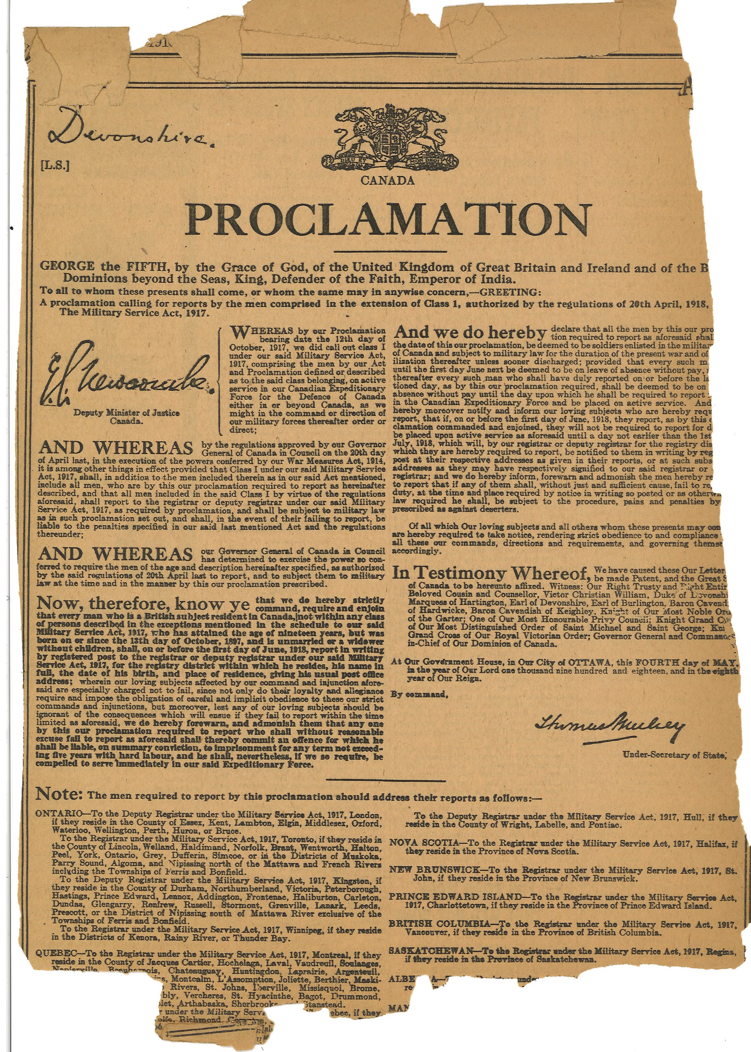
Notes:
Newspaper clippings. Includes the full proclamation of the Military Service Act, and a note about acceptable exemptions from the Act which included farmers or other types of skilled work. 1917.

Slide 4
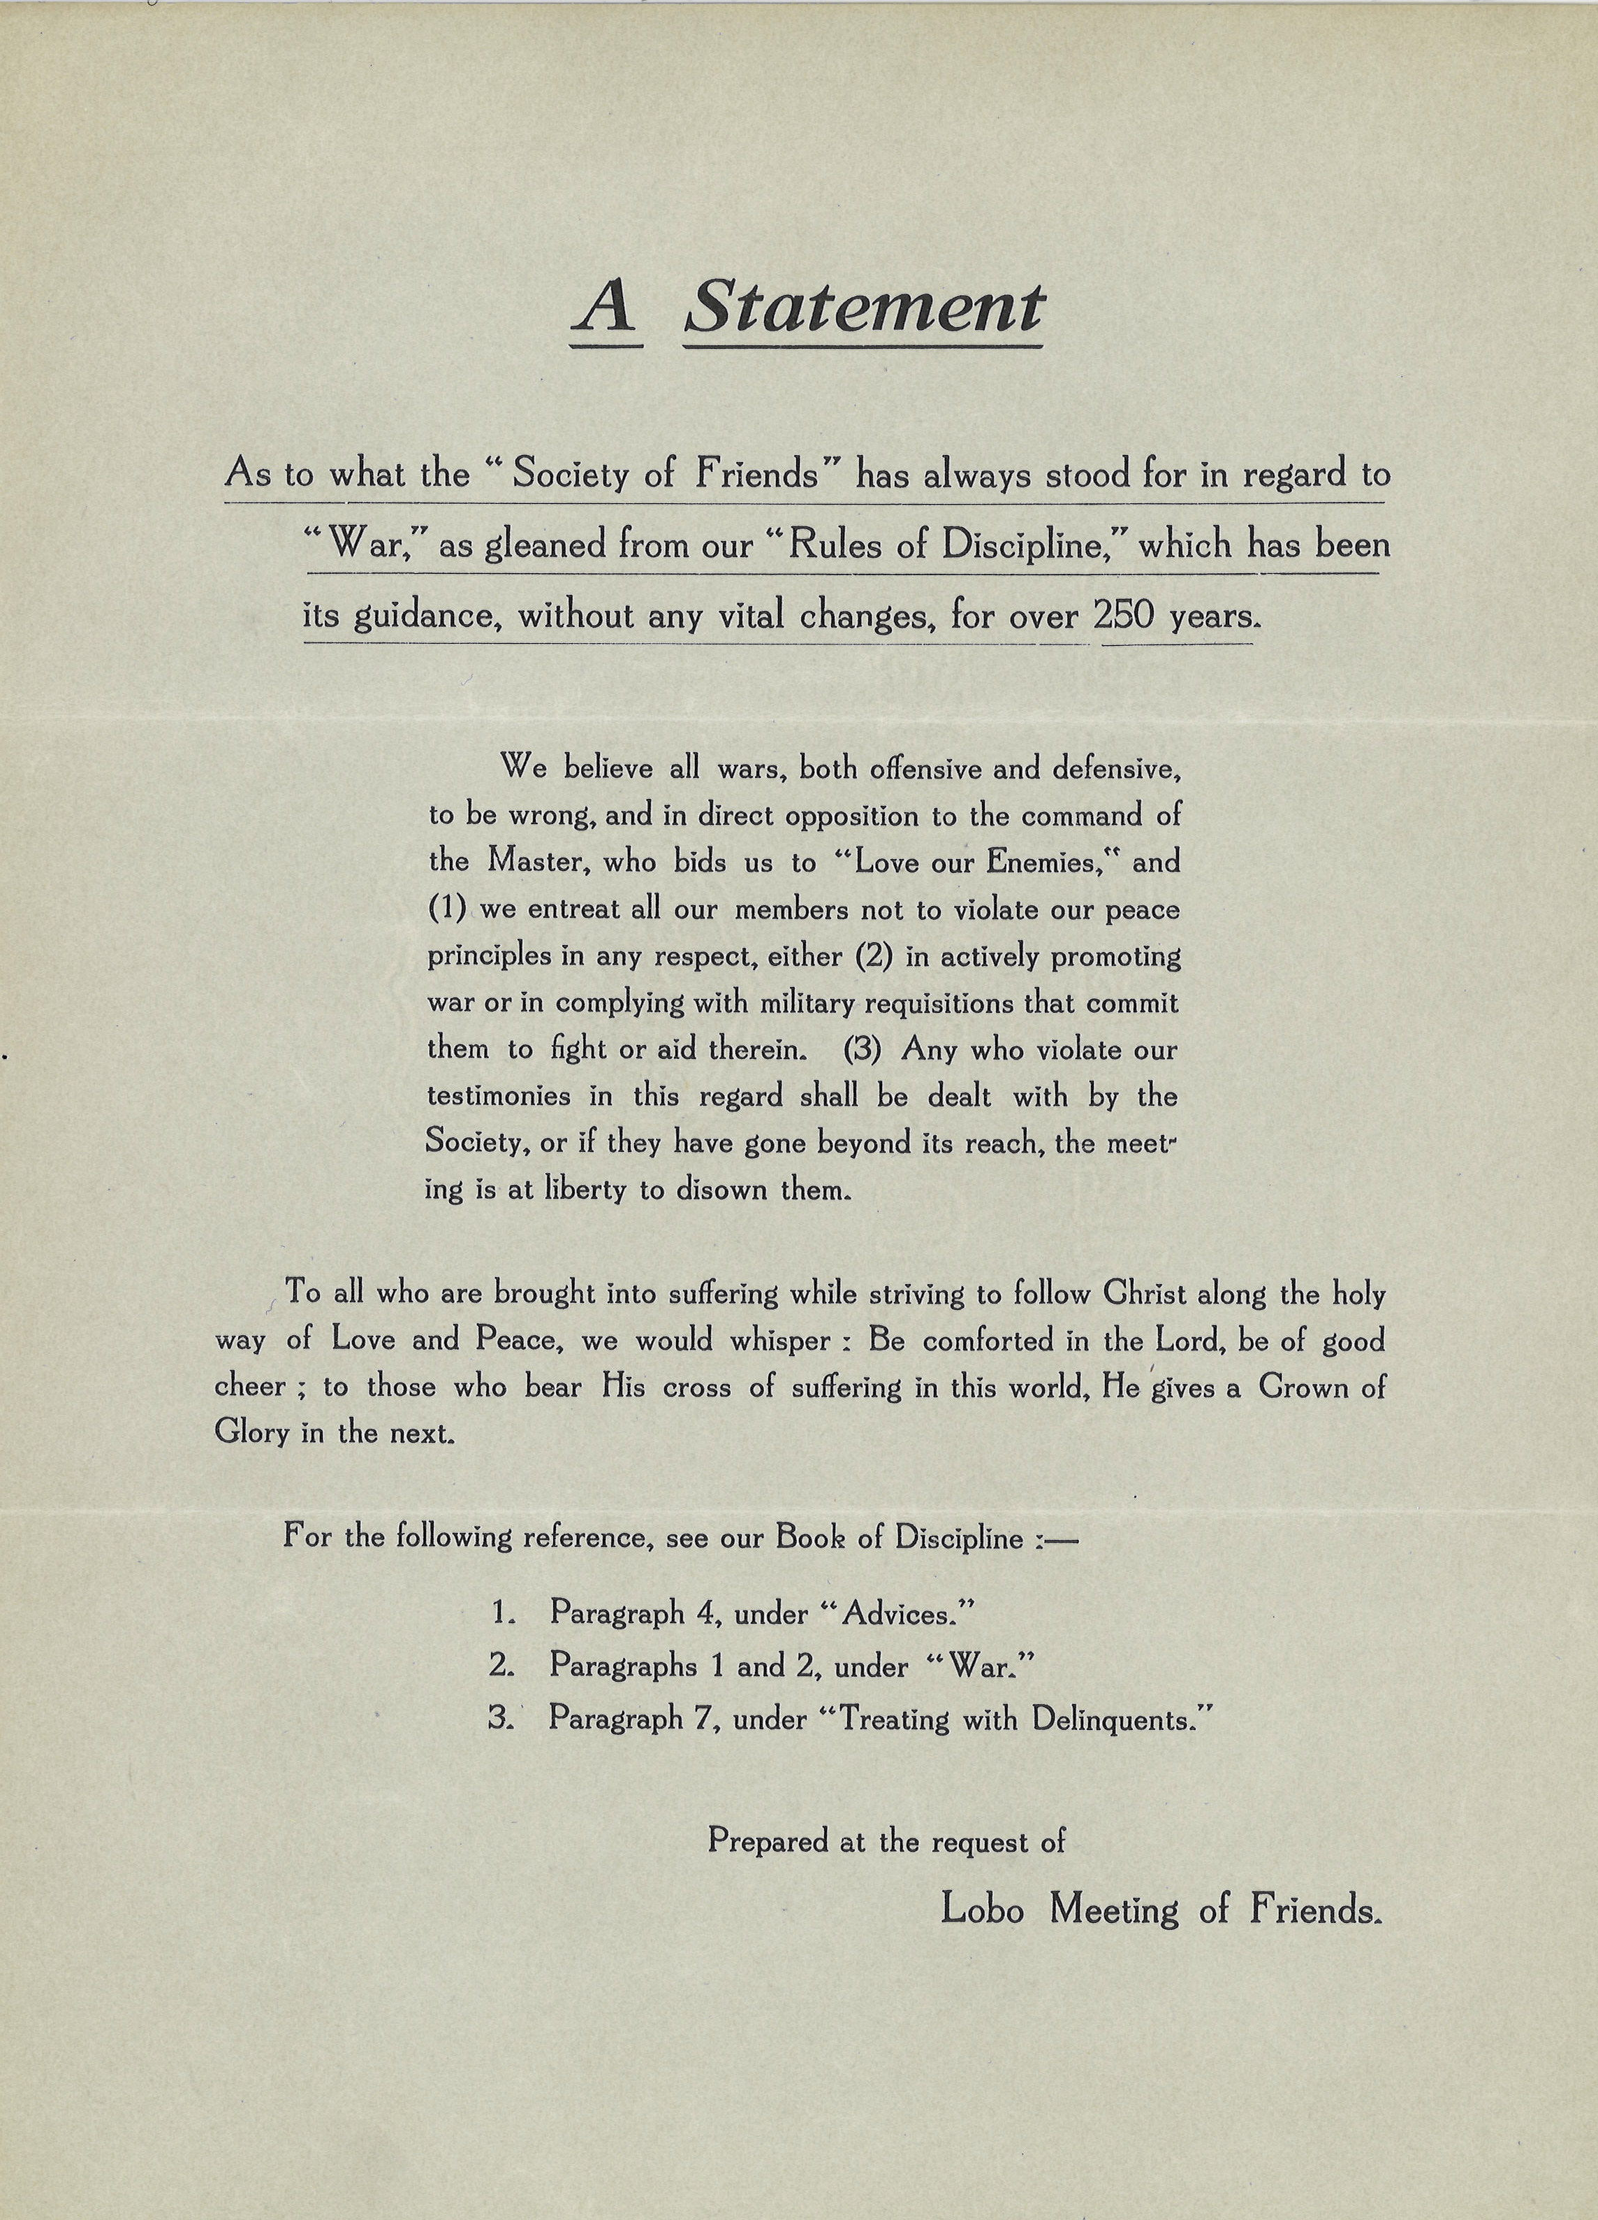
“We believe all wars, both offensive and defensive, to be wrong, and in direct opposition to the command of the Master, who bids us to “Love our Enemies” and (1) we entreat all our members not to violate our peace principles in any respect, either (2) in actively promoting war or in complying with military requisitions that commit them to fight or aid therein. (3) Any who violate our testimonies in this regard shall be dealt with by the Society, or if they have gone beyond its reach, the meeting is at liberty to disown them.”
Notes:
A statement from Lobo Meeting of Friends on the war, referencing the Rules of Discipline. 1917.

Slide 5
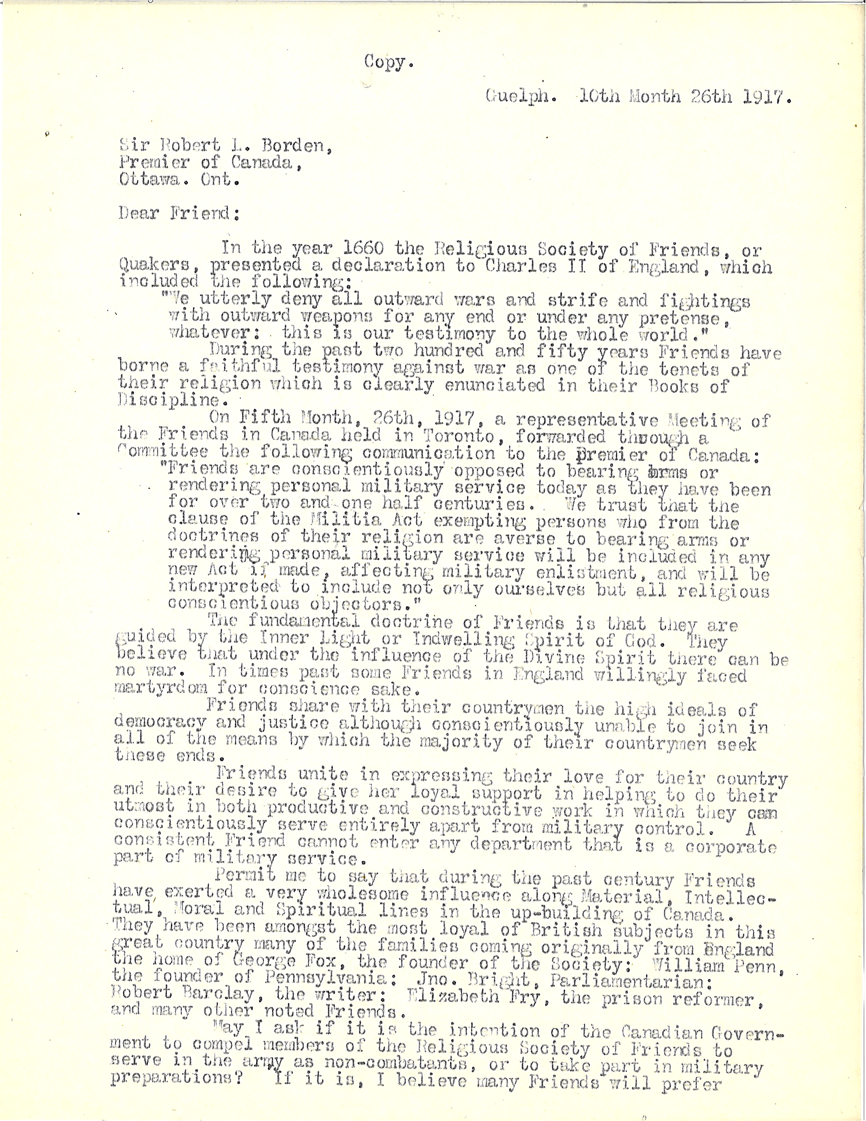
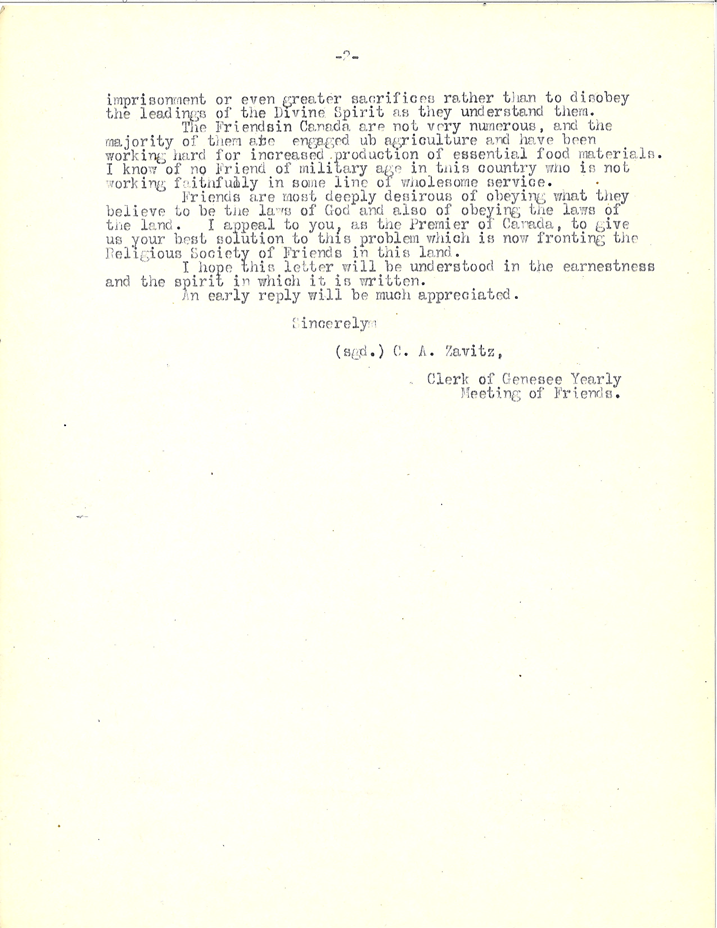
Notes:
A letter to Sir Robert L. Borden, Premier of Canada, from C.A. Zavitz, Clerk of Genesee Yearly Meeting. 1917.

Slide 6
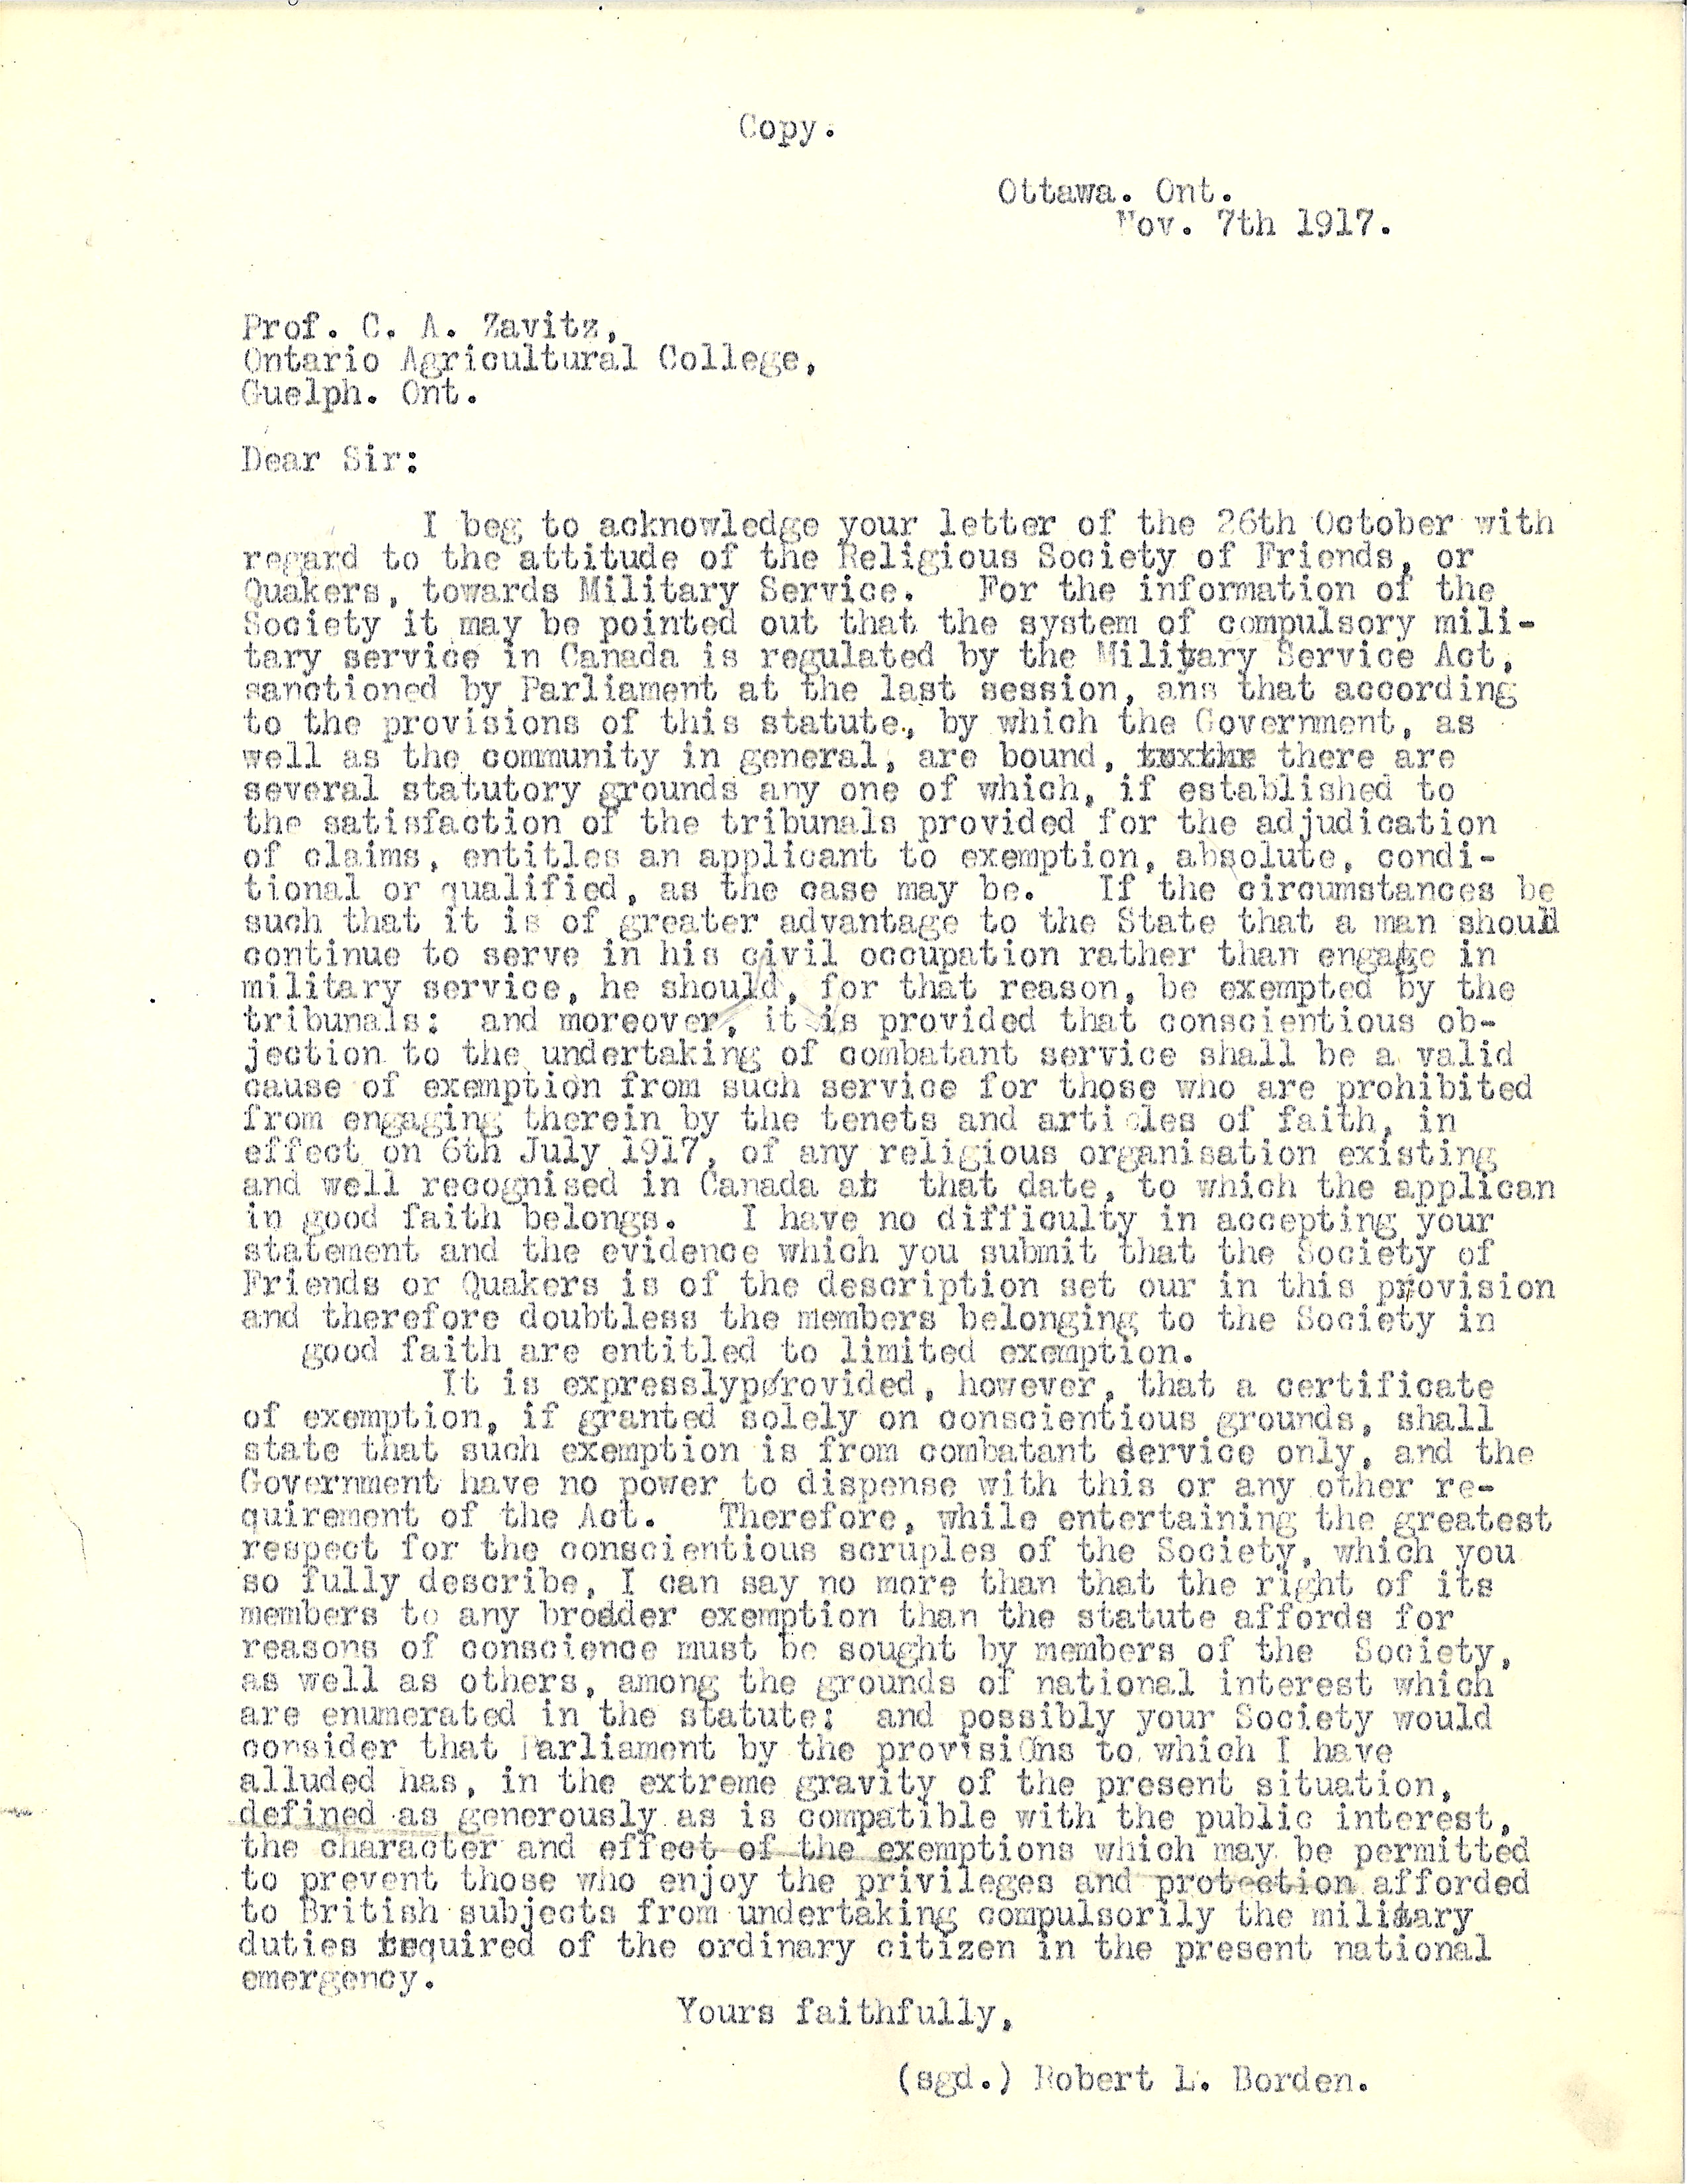
Notes:
A response from Sir Robert L. Borden, Premier of Canada, to C.A. Zavitz, Clerk of Genesee Yearly Meeting. 1917.

Slide 7
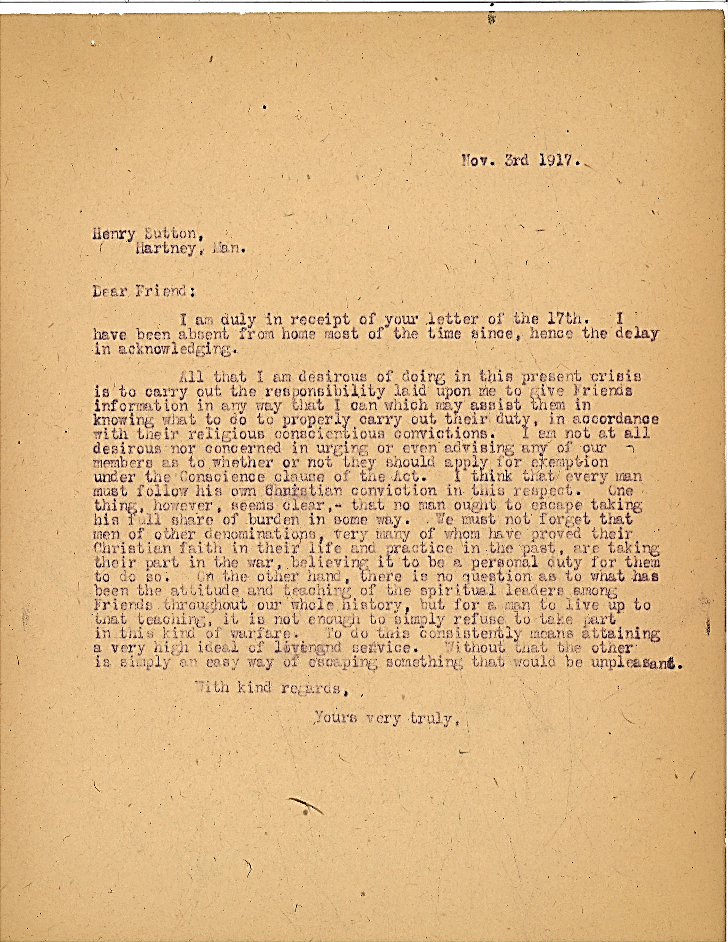
“One thing, however, seems clear – that no man ought to escape taking his full share of the burden in some way. We must not forget that men of other denominations, very many of whom have proved their Christian faith in their life and practice in the past, are taking their part in the war, believing it to be a personal duty for them to do so. On the other hand, there is no question as to what has been the attitude and teaching of the spiritual leaders among Friends throughout our whole history, but for a man to live up to that teaching, it is not enough to simply refuse to take part in this kind of warfare. To do this consistently means attaining a very high ideal of living and service. Without that the other is simply an easy way of escaping something that would be unpleasant.”
Notes:
A letter to Henry Sutton, Hartney, Man. from an unnamed Friend, discussing conscientious objection. 1917.

Slide 9
Notes:
A newspaper clipping from The Globe about the loan of Pickering College to the Military Hospitals Commission. 1917.

Slide 10
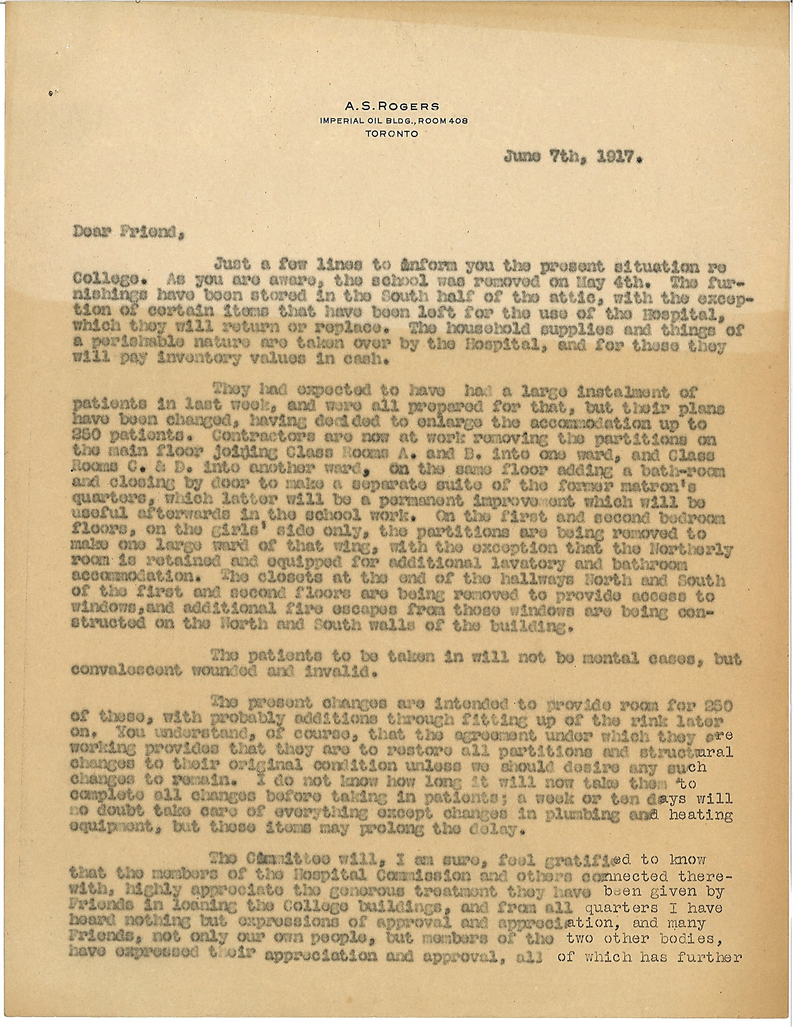
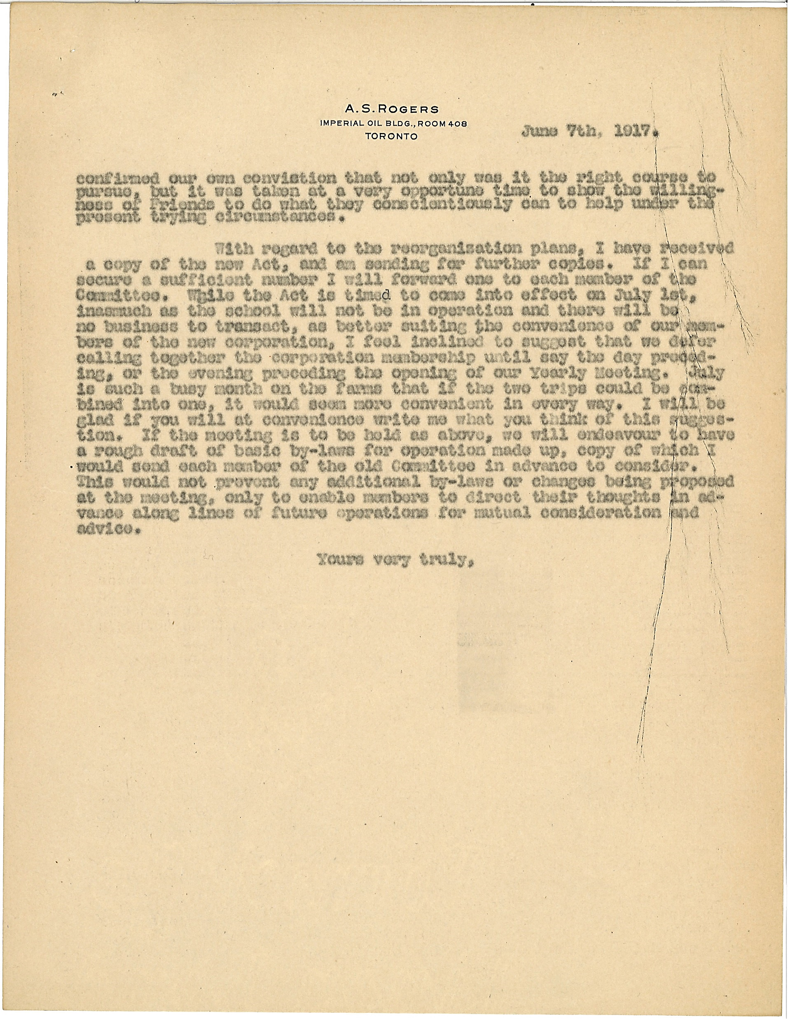
Notes:
A letter from A.S. Rogers to an unnamed Friend/Peace Committee speaking about the changes to Pickering College during the donation. 1917.

Slide 11
“Thus ended another chapter in the history of the school. But if indeed this had proved to be the last chapter, the final use of the school building as an asylum for the wreckage of war would have been an end quite worthy of the humanitarian tradition which had long been associated with the Society of Friends.”
Notes:
An excerpt from A Hundred Years of Quaker Education in Canada by Arthur G. Dorland. 1942.

Slide 12
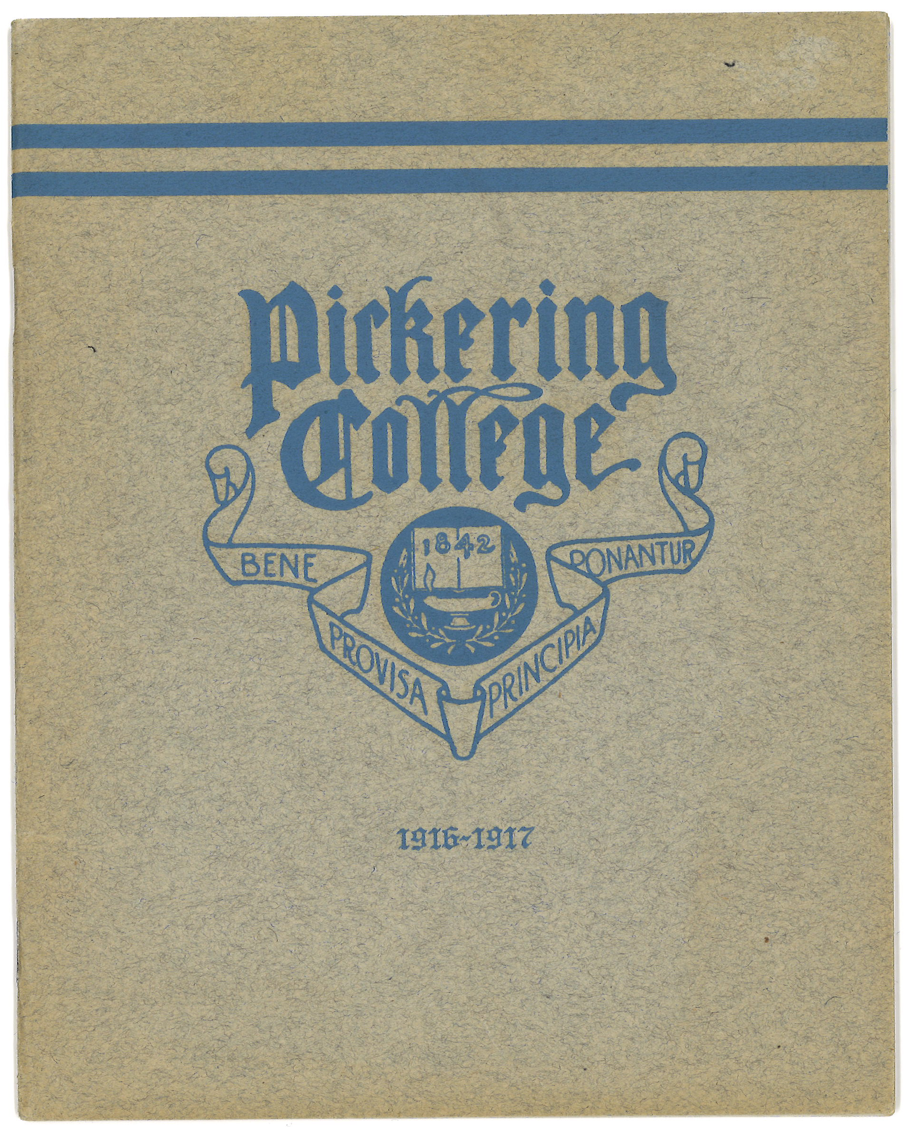
Notes:
A pamphlet from Pickering College, 1916-1917.

Slide 13
Notes:
Photographs of Rogers House interior and exteriors. 1916-1917.

Slide 14
Notes:
Photographs of the Assembly Room. 1916-1917.

Slide 15
Notes:
Photographs of the Reception Hall. 1916-1917.

Slide 16
Notes:
Photographs of various classrooms and locations in Rogers House. 1916-1917.

Slide 17
Notes:
Daily school routine schedule and expenses. 1916-1917.

